Slide 1
Web Crawling and Basic Text Analysis
Hongning Wang
CS@UVa

Slide 2
Recap: core IR concepts
Information need
An IR system is to satisfy users’ information need
Query
A designed representation of users’ information need
Document
A representation of information that potentially satisfies users’ information need
Relevance
Relatedness between documents and users’ information need

Slide 3
Recap: Browsing v.s. Querying
Browsing
Works well when the user wants to explore information or doesn’t know what keywords to use, or cannot conveniently enter a query
Querying
Works well when the user knows exactly what query to use for expressing her information need

Slide 4
Recap: Pull v.s. Push in IR
Pull mode – with query
User takes the initiative
Works well when a user has an ad hoc information need
Push mode – without query
System takes the initiative
Works well when a user has a stable information need or the system has good knowledge about a user’s need

Slide 5
Abstraction of search engine architecture
Indexed corpus
Crawler
Ranking procedure
Feedback
Evaluation
Doc Analyzer
(Query)
Query Rep
User
Doc Representation
Ranker
Indexer
results
Index

Slide 6
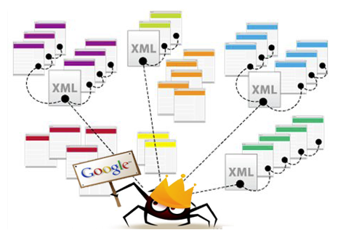
Web crawler
A automatic program that systematically browses the web for the purpose of Web content indexing and updating
Synonyms: spider, robot, bot

Slide 7
How does it work
In pseudo code
Def Crawler(entry_point) {
URL_list = [entry_point]
while (len(URL_list)>0) {
URL = URL_list.pop();
if (isVisited(URL) or !isLegal(URL) or !checkRobotsTxt(URL))
continue;
HTML = URL.open();
for (anchor in HTML.listOfAnchors()) {
URL_list .append(anchor);
}
setVisited(URL);
insertToIndex(HTML);
}
}
Which page to visit next?
Is it visited already? Or shall we visit it again?
Is the access granted?

Slide 8
Visiting strategy
Breadth first
Uniformly explore from the entry page
Memorize all nodes on the previous level
As shown in pseudo code
Depth first
Explore the web by branch
Biased crawling given the web is not a tree structure
Focused crawling
Prioritize the new links by predefined strategies

Slide 9
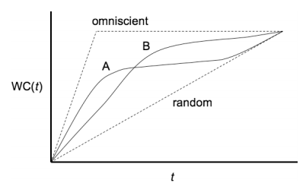

Focused crawling
Prioritize the visiting sequence of the web
The size of Web is too large for a crawler (even Google) to completely cover
Not all documents are equally important
Emphasize more on the high-quality documents
Maximize weighted coverage
In 1999, no search engine indexed more than 16% of the Web
In 2005, large-scale search engines index no more than 40-70% of the indexable Web
Importance of page p
Weighted coverage till time t
Pages crawled till time t

Slide 10
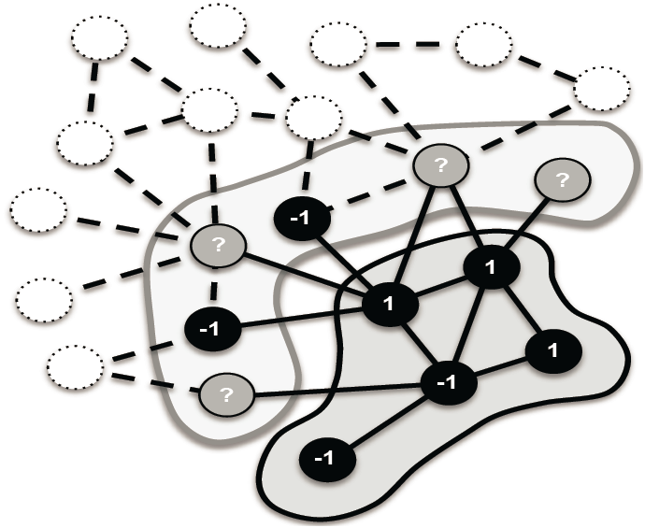
Focused crawling
Prioritize by in-degree ^{[Cho et al. WWW’98]}
The page with the highest number of incoming hyperlinks from previously downloaded pages is downloaded next
Prioritize by PageRank [Abiteboul et al. WWW’07, Cho and Uri VLDB’07]
Breadth-first in early stage, then compute/approximate PageRank periodically
More consistent with search relevance ^{[Fetterly et al. SIGIR’09]}

Slide 11
Focused crawling
Prioritize by topical relevance
In vertical search, only crawl relevant pages ^{[De et al. WWW’94]}
E.g., restaurant search engine should only crawl restaurant pages
Estimate the similarity to current page by anchortext or text near anchor ^{[Hersovici et al. WWW’98]}
User given taxonomy or topical classifier ^{[Chakrabarti et al. WWW’98]}

Slide 12
Avoid duplicate visit
Given web is a graph rather than a tree, avoid loop in crawling is important
What to check
URL: must be normalized, not necessarily can avoid all duplication
http://dl.acm.org/event.cfm?id=RE160&CFID=516168213&CFTOKEN=99036335
http://dl.acm.org/event.cfm?id=RE160
Page: minor change might cause misfire
Timestamp, data center ID change in HTML
How to check
trie or hash table

Slide 13
Politeness policy
Crawlers can retrieve data much quicker and in greater depth than human searchers
Costs of using Web crawlers
Network resources
Server overload
Robots exclusion protocol
Examples: CNN, UVa

Slide 14
Robot exclusion protocol examples
Exclude specific directories:
User-agent: *
Disallow: /tmp/
Disallow: /cgi-bin/
Disallow: /users/paranoid/
Exclude a specific robot:
User-agent: GoogleBot
Disallow: /
Allow a specific robot:
User-agent: GoogleBot
Disallow:
User-agent: *
Disallow: /

Slide 15
Re-visit policy
The Web is very dynamic; by the time a Web crawler has finished its crawling, many events could have happened, including creations, updates and deletions
Keep re-visiting the crawled pages
Maximize freshness and minimize age of documents in the collection
Strategy
Uniform re-visiting
Proportional re-visiting
Visiting frequency is proportional to the page’s update frequency

Slide 16
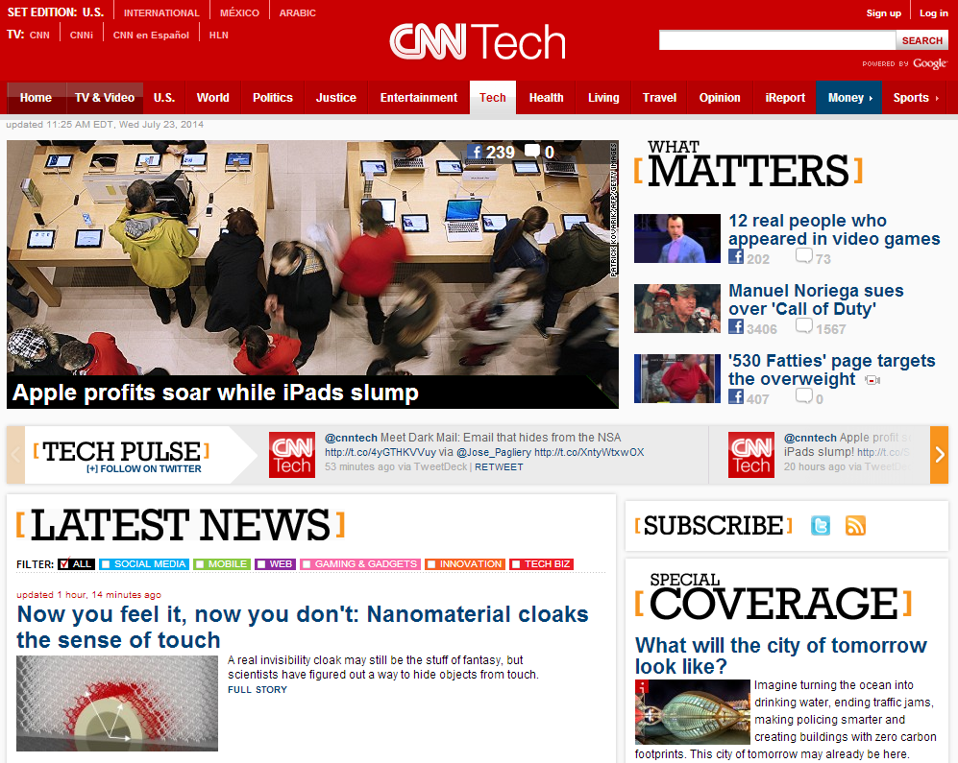
Analyze crawled web pages
What you care from the crawled web pages

Slide 17
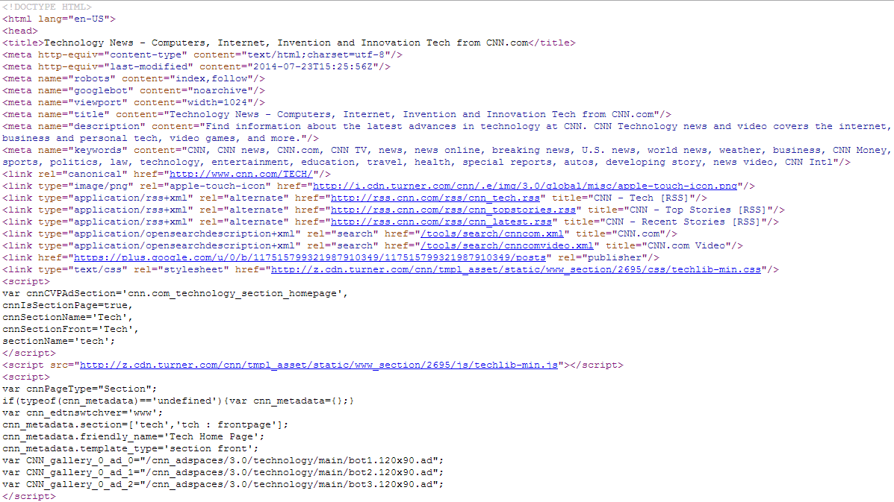
Analyze crawled web pages
What machine knows from the crawled web pages

Slide 18
Basic text analysis techniques
Needs to analyze and index the crawled web pages
Extract informative content from HTML
Build machine accessible data representation

Slide 19
HTML parsing
Generally difficult due to the free style of HTML
Solutions
Shallow parsing
Remove all HTML tags
Only keep text between <title></title> and <p></p>
Automatic wrapper generation ^{[Crescenzi et al. VLDB’01]}
Wrapper: regular expression for HTML tags’ combination
Inductive reasoning from examples
Visual parsing ^{[Yang and Zhang DAR’01]}
Frequent pattern mining of visually similar HTML blocks

Slide 20
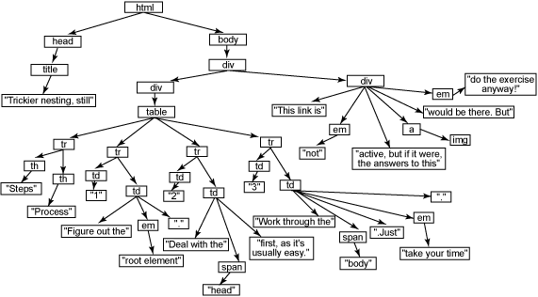
HTML parsing
jsoup
Java-based HTML parser
scrape and parse HTML from a URL, file, or string to DOM tree
Find and extract data, using DOM traversal or CSS selectors
children(), parent(), siblingElements()
getElementsByClass(), getElementsByAttributeValue()
Python version: Beautiful Soup

Slide 21
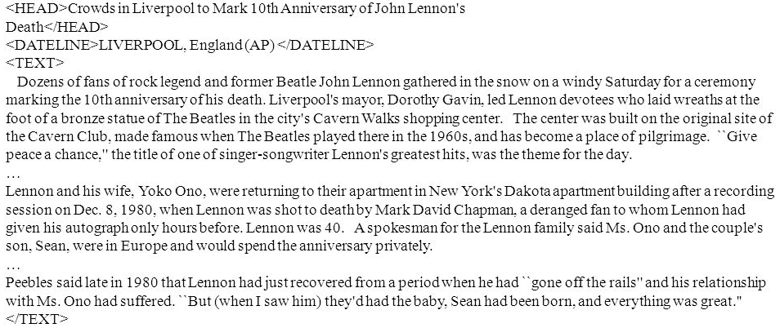
How to represent a document
Represent by a string?
No semantic meaning
Represent by a list of sentences?
Sentence is just like a short document (recursive definition)
Represent by a list of words?
Tokenize it first
Bag-of-Words representation!

Slide 22
Tokenization
Break a stream of text into meaningful units
Tokens: words, phrases, symbols
Definition depends on language, corpus, or even context
Input: It’s not straight-forward to perform so-called “tokenization.”
Output(1): 'It’s', 'not', 'straight-forward', 'to', 'perform', 'so-called', '“tokenization.”'
Output(2): 'It', '’', 's', 'not', 'straight', '-', 'forward, 'to', 'perform', 'so', '-', 'called', ‘“', 'tokenization', '.', '”‘

Slide 23
Tokenization
Solutions
Regular expression
[\w]+: so-called -> ‘so’, ‘called’
[\S]+: It’s -> ‘It’s’ instead of ‘It’, ‘’s’
Statistical methods
Explore rich features to decide where is the boundary of a word
Apache OpenNLP (http://opennlp.apache.org/)
Stanford NLP Parser (http://nlp.stanford.edu/software/lex-parser.shtml)
Online Demo
Stanford (http://nlp.stanford.edu:8080/parser/index.jsp)
UIUC (http://cogcomp.cs.illinois.edu/curator/demo/index.html)

Slide 24
Full text indexing
Bag-of-Words representation
Doc1: Information retrieval is helpful for everyone.
Doc2: Helpful information is retrieved for you.
 | information | retrieval | retrieved | is | helpful | for | you | everyone
Doc1 | 1 | 1 | 0 | 1 | 1 | 1 | 0 | 1
Doc2 | 1 | 0 | 1 | 1 | 1 | 1 | 1 | 0
Word-document adjacency matrix

Slide 25
Full text indexing
Bag-of-Words representation
Assumption: word is independent from each other
Pros: simple
Cons: grammar and order are missing
The most frequently used document representation
Image, speech, gene sequence

Slide 26
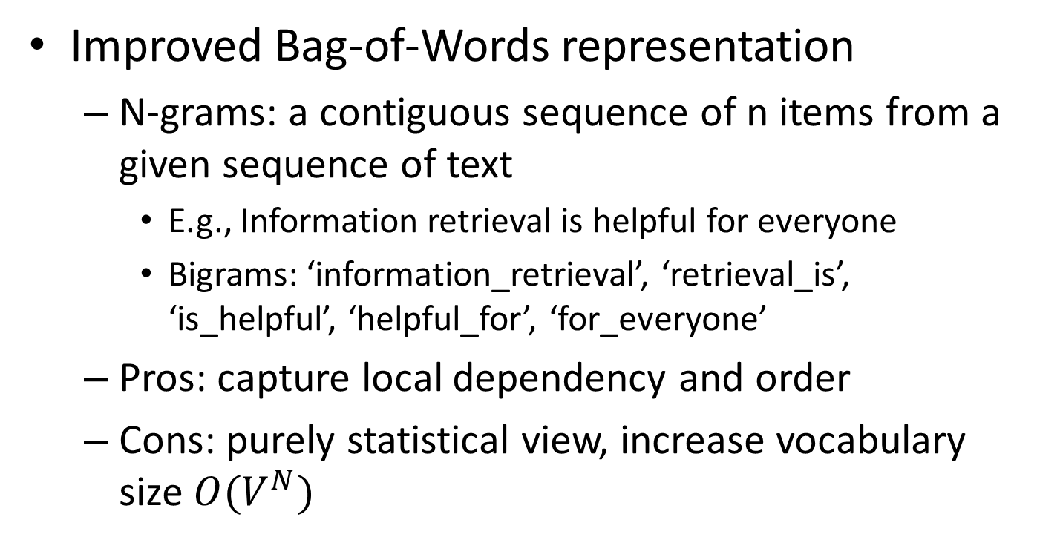
Full text indexing
Improved Bag-of-Words representation
N-grams: a contiguous sequence of n items from a given sequence of text
E.g., Information retrieval is helpful for everyone
Bigrams: ‘information_retrieval’, ‘retrieval_is’, ‘is_helpful’, ‘helpful_for’, ‘for_everyone’
Pros: capture local dependency and order
Cons: purely statistical view, increase vocabulary size $O(V^{N})$

Slide 27
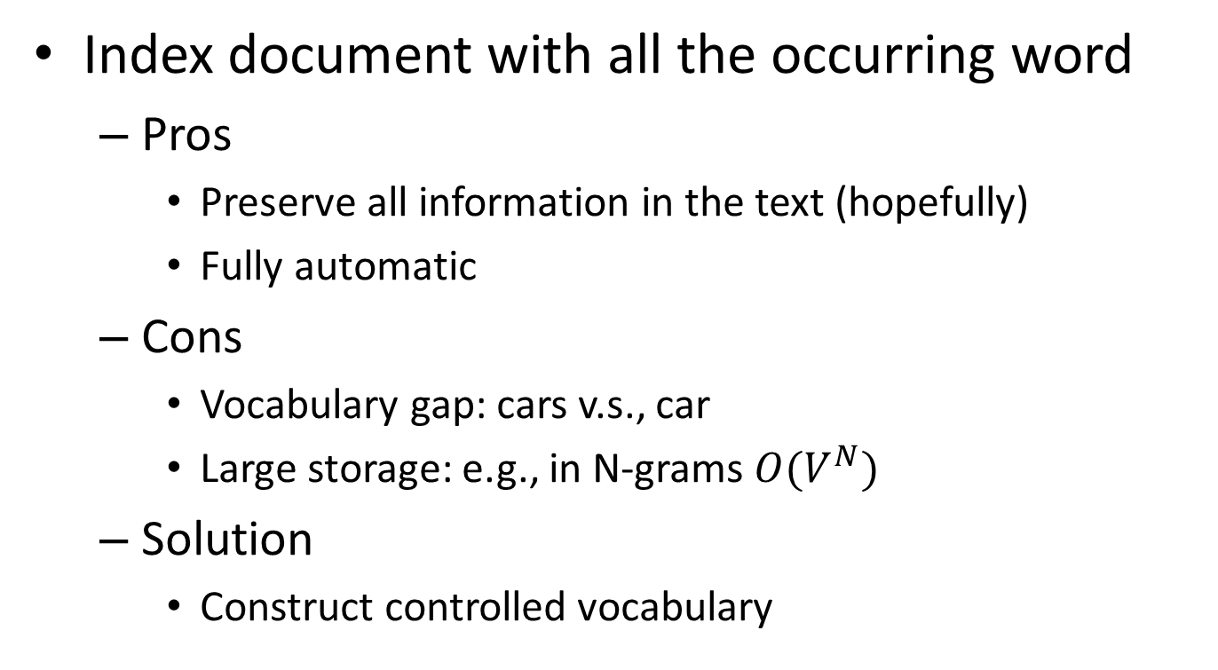
Full text indexing
Index document with all the occurring word
Pros
Preserve all information in the text (hopefully)
Fully automatic
Cons
Vocabulary gap: cars v.s., car
Large storage: e.g., in N-grams $O(V^{N})$
Solution
Construct controlled vocabulary

Slide 28
Recap: web crawling
In pseudo code
Def Crawler(entry_point) {
URL_list = [entry_point]
while (len(URL_list)>0) {
URL = URL_list.pop();
if (isVisited(URL) or !isLegal(URL) or !checkRobotsTxt(URL))
continue;
HTML = URL.open();
for (anchor in HTML.listOfAnchors()) {
URL_list .append(anchor);
}
setVisited(URL);
insertToIndex(HTML);
}
}
Which page to visit next?
Is it visited already? Or shall we visit it again?
Is the access granted?

Slide 29
Recap: crawling strategy
Breadth first
Uniformly explore from the entry page
Depth first
Biased crawling given the web is not a tree structure
Focused crawling
Prioritize by in-degree ^{[Cho et al. WWW’98]}
Prioritize by PageRank [Abiteboul et al. WWW’07, Cho and Uri VLDB’07]
Prioritize by topical relevance

Slide 30
Recap: challenges in web crawling
Avoid duplicate visit
Recognize URLs pointing to the same content
Re-visit policy
Maximize freshness and minimize age of documents in the collection

Slide 31
Recap: HTML parsing
Shallow parsing
Only keep text between <title></title> and <p></p>
Automatic wrapper generation ^{[Crescenzi et al. VLDB’01]}
Wrapper: regular expression for HTML tags’ combination
Visual parsing ^{[Yang and Zhang DAR’01]}
Frequent pattern mining of visually similar HTML blocks

Slide 32
Recap: full text indexing
Bag-of-Words representation
Doc1: Information retrieval is helpful for everyone.
Doc2: Helpful information is retrieved for you.
 | information | retrieval | retrieved | is | helpful | for | you | everyone
Doc1 | 1 | 1 | 0 | 1 | 1 | 1 | 0 | 1
Doc2 | 1 | 0 | 1 | 1 | 1 | 1 | 1 | 0
Word-document adjacency matrix

Slide 33
Recap: tokenization
Break a stream of text into meaningful units
Rule-based solution: regular expressions
Statistical methods: learning-based solution to predict word boundaries

Slide 34
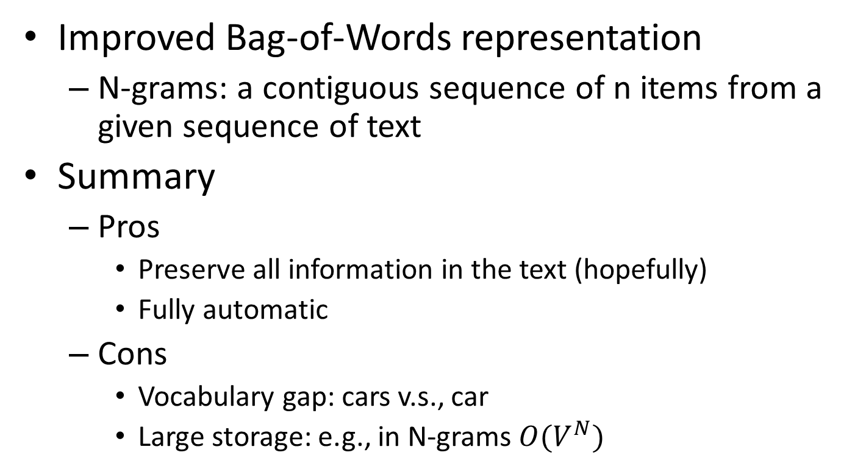
Recap: full text indexing
Improved Bag-of-Words representation
N-grams: a contiguous sequence of n items from a given sequence of text
Summary
Pros
Preserve all information in the text (hopefully)
Fully automatic
Cons
Vocabulary gap: cars v.s., car
Large storage: e.g., in N-grams $O(V^{N})$

Slide 35
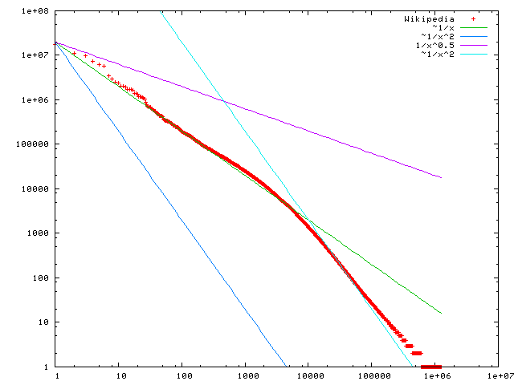

Statistical property of language
Zipf’s law
Frequency of any word is inversely proportional to its rank in the frequency table
Formally
$f\left(k;s,N\right)=\frac{1/k^{s}}{\sum_{n=1}^{N}{1/n^{s}}}$
where $k$ is rank of the word; $N$ is the vocabulary size; $s$ is language-specific parameter
discrete version of power law
Word frequency
In the Brown Corpus of American English text, the word "the" is the most frequently occurring word, and by itself accounts for nearly 7% of all word occurrences; the second-place word "of" accounts for slightly over 3.5% of words.
Word rank by frequency
A plot of word frequency in Wikipedia (Nov 27, 2006)

Slide 36
Zipf’s law tells us
Head words may take large portion of occurrence, but they are semantically meaningless
E.g., the, a, an, we, do, to
Tail words take major portion of vocabulary, but they rarely occur in documents
E.g., dextrosinistral
The rest is most representative
To be included in the controlled vocabulary

Slide 37
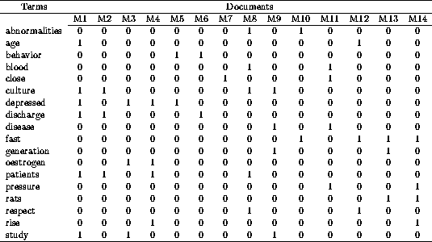
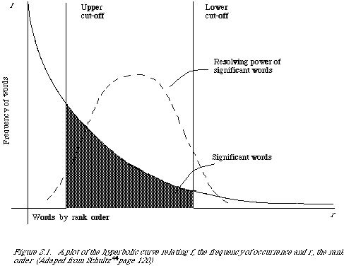
Automatic text indexing
Remove non-informative words
Remove 1s
Remove 0s
Remove rare words

Slide 38
Normalization
Convert different forms of a word to normalized form in the vocabulary
U.S.A -> USA, St. Louis -> Saint Louis
Solution
Rule-based
Delete periods and hyphens
All in lower case
Dictionary-based
Construct equivalent class
Car -> “automobile, vehicle”
Mobile phone -> “cellphone”

Slide 39
Stemming
Reduce inflected or derived words to their root form
Plurals, adverbs, inflected word forms
E.g., ladies -> lady, referring -> refer, forgotten -> forget
Bridge the vocabulary gap
Risk: lose precise meaning of the word
E.g., lay -> lie (a false statement? or be in a horizontal position?)
Solutions (for English)
Porter stemmer: pattern of vowel-consonant sequence
Krovetz Stemmer: morphological rules

Slide 40
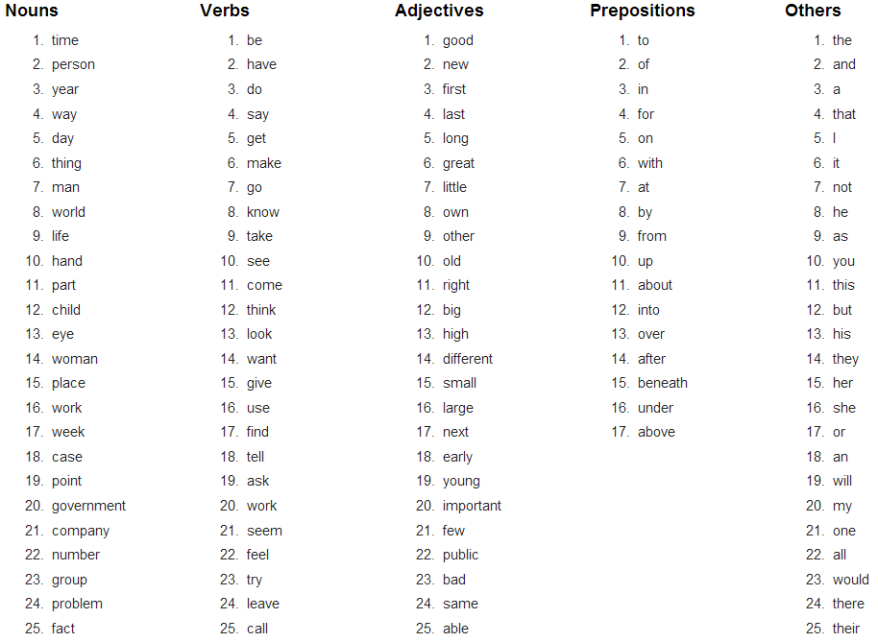
Stopwords
Useless words for query/document analysis
Not all words are informative
Remove such words to reduce vocabulary size
No universal definition
Risk: break the original meaning and structure of text
E.g., this is not a good option -> option
to be or not to be -> null
The OEC: Facts about the language

Slide 41
Abstraction of search engine architecture
Indexed corpus
Visiting strategy
Avoid duplicated visit
Re-visit policy
Crawler
HTML parsing
Tokenization
Stemming/normalization
Stopword/controlled vocabulary filter
Doc Analyzer
Doc Representation
BagOfWord representation!

Slide 42
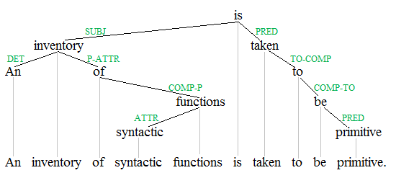
Automatic text indexing
In modern search engine
No stemming or stopword removal, since computation and storage are no longer the major concern
More advanced NLP techniques are applied
Named entity recognition
E.g., people, location and organization
Dependency parsing
Query: “to be or not to be”

Slide 43
What you should know
Basic techniques for crawling
Zipf’s law
Procedures for automatic text indexing
Bag-of-Words document representation

Slide 44
Today’s reading
Introduction to Information Retrieval
Chapter 20: Web crawling and indexes
Section 20.1, Overview
Section 20.2, Crawling
Chapter 2: The term vocabulary and postings lists
Section 2.2, Determining the vocabulary of terms
Chapter 5: Index compression
Section 5.1, Statistical properties of terms in information retrieval

Slide 45
Reference I
Cho, Junghoo, Hector Garcia-Molina, and Lawrence Page. "Efficient crawling through URL ordering." Computer Networks and ISDN Systems 30.1 (1998): 161-172.
Abiteboul, Serge, Mihai Preda, and Gregory Cobena. "Adaptive on-line page importance computation." Proceedings of the 12th international conference on World Wide Web. ACM, 2003.
Cho, Junghoo, and Uri Schonfeld. "RankMass crawler: a crawler with high personalized pagerank coverage guarantee." Proceedings of the 33rd international conference on Very large data bases. VLDB Endowment, 2007.
Fetterly, Dennis, Nick Craswell, and Vishwa Vinay. "The impact of crawl policy on web search effectiveness." Proceedings of the 32nd international ACM SIGIR conference on Research and development in information retrieval. ACM, 2009.
De Bra, Paul ME, and R. D. J. Post. "Information retrieval in the World-Wide Web: making client-based searching feasible." Computer Networks and ISDN Systems 27.2 (1994): 183-192.
Hersovici, Michael, et al. "The shark-search algorithm. An application: tailored Web site mapping." Computer Networks and ISDN Systems 30.1 (1998): 317-326.

Slide 46
Reference II
Chakrabarti, Soumen, Byron Dom, Prabhakar Raghavan, Sridhar Rajagopalan, David Gibson, and Jon Kleinberg. "Automatic resource compilation by analyzing hyperlink structure and associated text." Computer Networks and ISDN Systems 30, no. 1 (1998): 65-74.
Crescenzi, Valter, Giansalvatore Mecca, and Paolo Merialdo. "Roadrunner: Towards automatic data extraction from large web sites." VLDB. Vol. 1. 2001.
Yang, Yudong, and HongJiang Zhang. "HTML page analysis based on visual cues." Document Analysis and Recognition, 2001. Proceedings. Sixth International Conference on. IEEE, 2001.

